Slide 1


HVS​
Concept of Range Estimation

Slide 2

Contents
Mileage Integral
Capacity Integral
Range Estimation

Slide 3
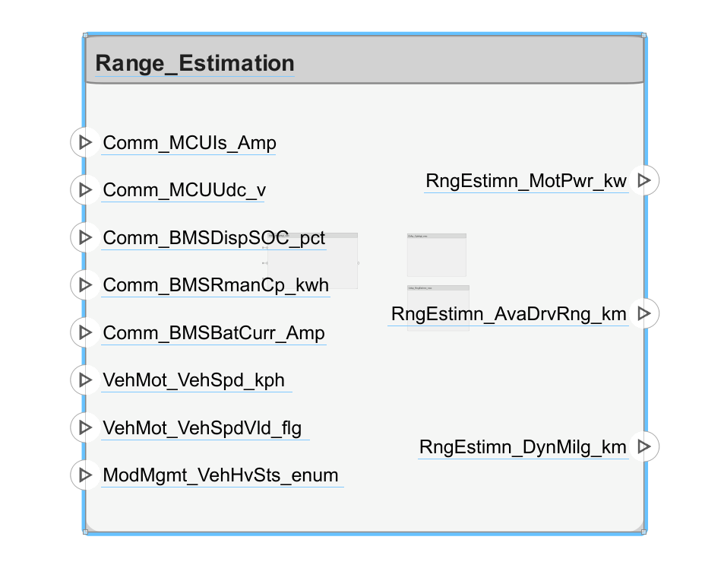
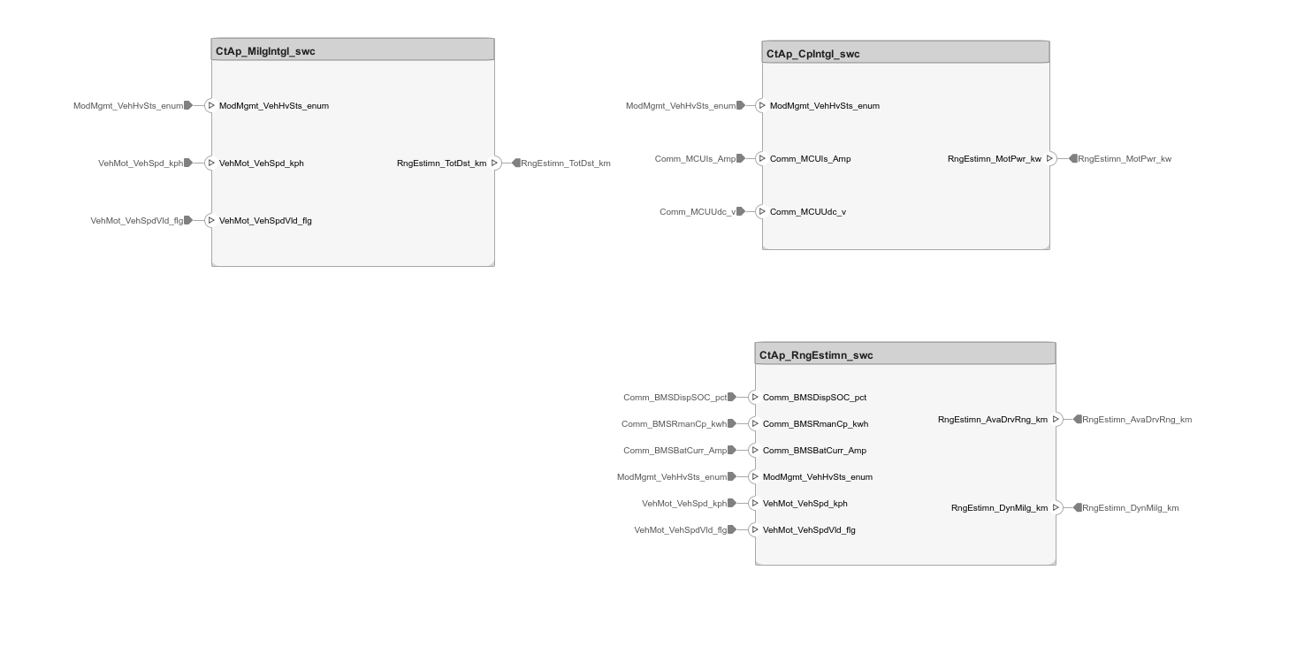
Function Behavior

Slide 4
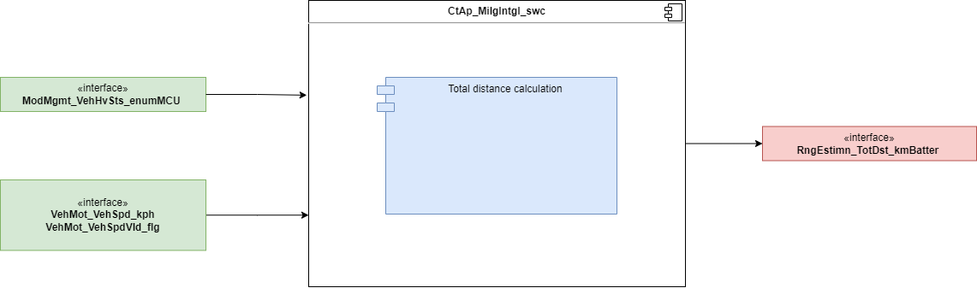
Mileage Integral
The Mileage Integral function use vehicle speed calculation vehicle total mileage

Slide 5
Capacity Integral
The Capacity Integral function use Motor Udc and Idc calculation Motor power

Slide 6
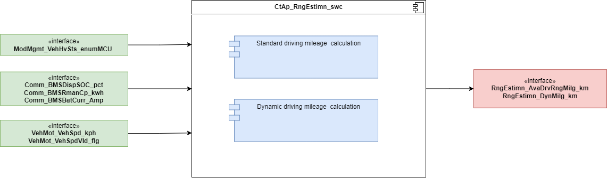
Range Estimation
The Range Estimation function calculates the remaining driving range in two ways according to the SOC value of the battery, the remaining capacity of the battery, the speed, the current and other information. The calculated remaining driving range is displayed through the instrument and central control.

Slide 7
Backup

